Slide 1
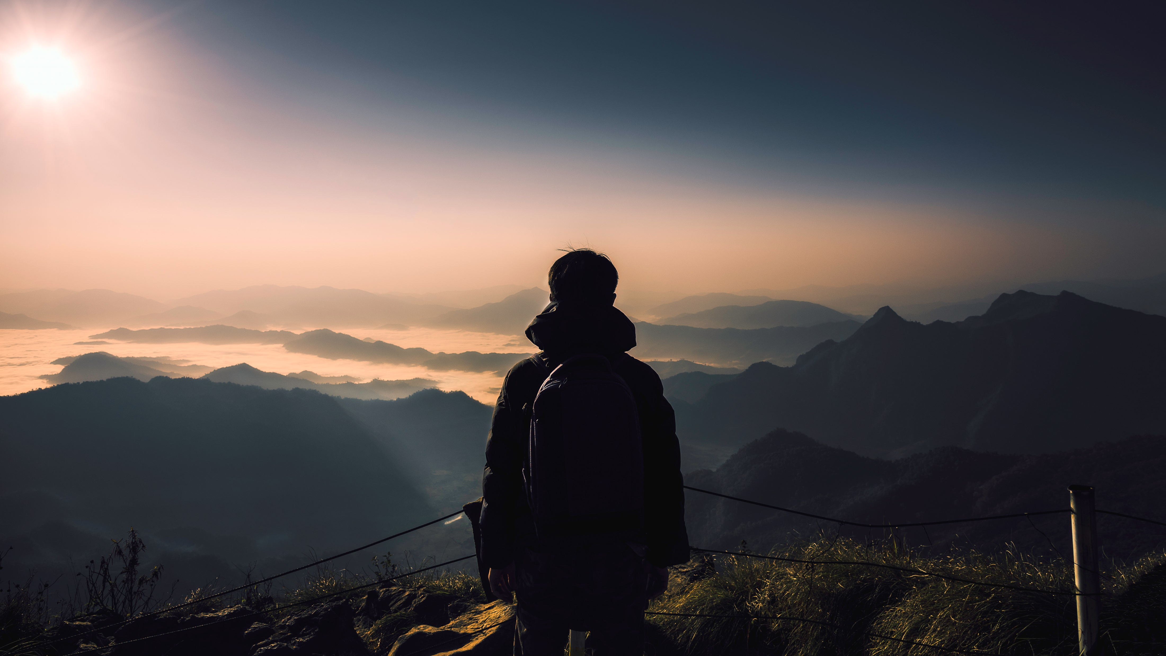
SSG TRAVEL
Digital Nomad Guide:
The better way to enjoy your world as a nomad

Slide 2
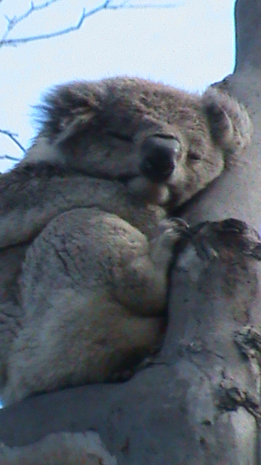
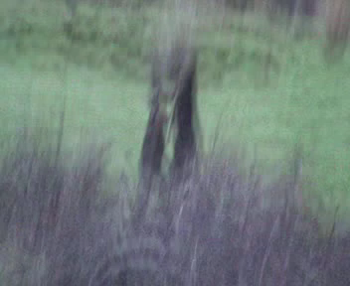
Visit Australia
Best price and availability
Decide on a Location
Set Itinerary

Slide 3
Common Travel Seasons

Slide 4
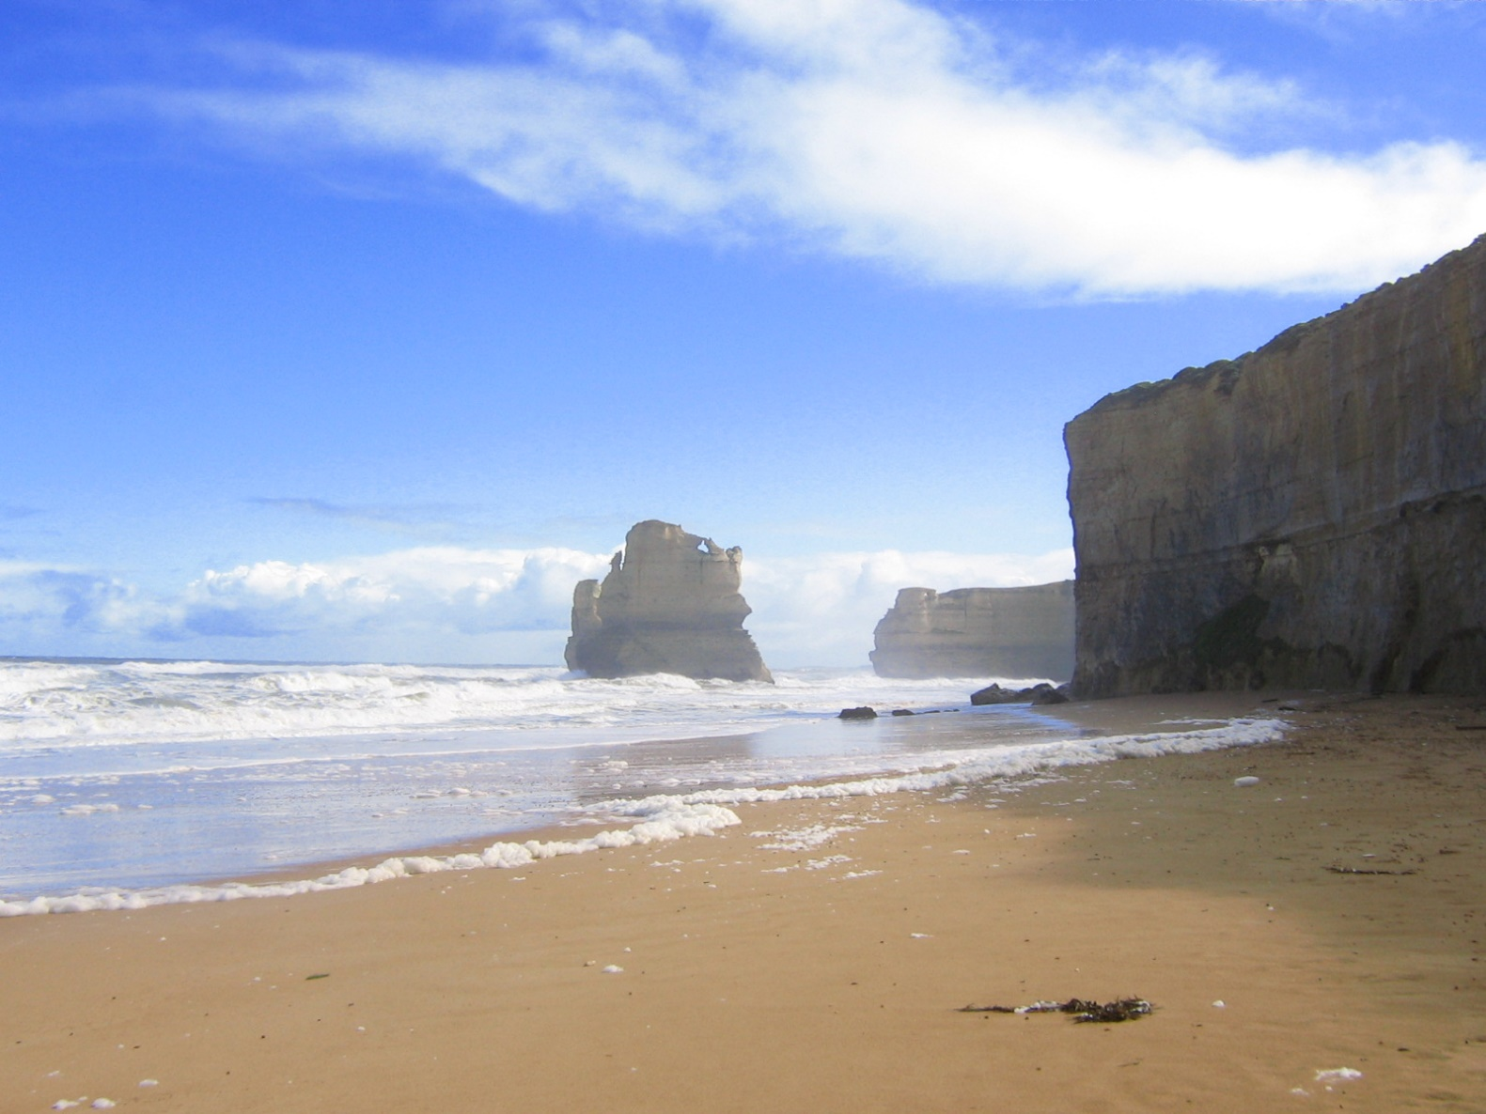

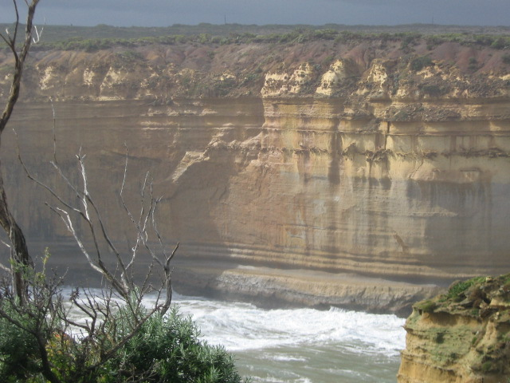
Make a Plan
Set a destination and/or travel theme
1
Set travel dates, mode of travel, and find accommodations
2
Find local attractions, food venues, and activities
3

Slide 5
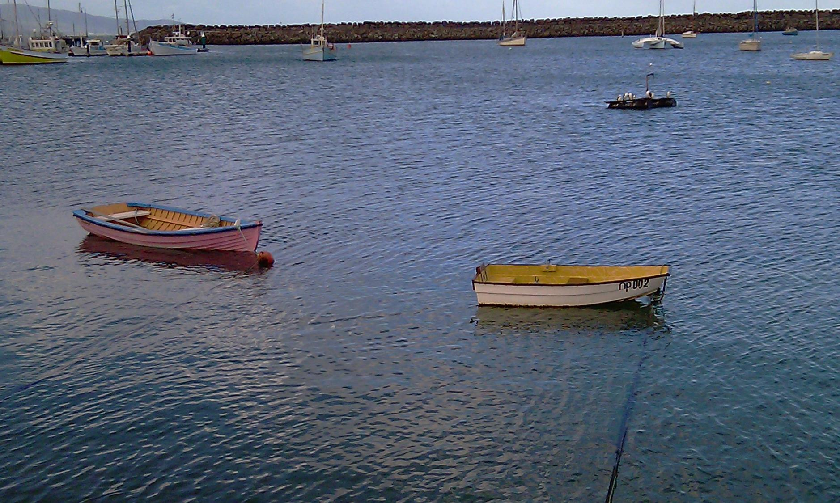
Thank you
safestsol@ssg.in

